Slide 1
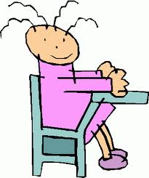
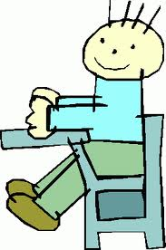
Be in your seats with materials out on your desks when the bell rings

Slide 2
Positive comments only

Slide 3
Always be respectful

Slide 4
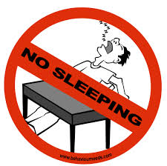
Heads up and no sleeping

Slide 5
No food, no drinks; water only

Slide 6
No cell phones

